Slide 1



Speaker Audio Amplifier
DEPARTMENT OF ELECTRONICS AND COMMUNICATION ENGINEERING
By:
RENUGA K

Slide 2
Contents
Objectives
Diagram
Abstract
Working Principle
Components
Advantages
Applications
References

Slide 3
Objectives
The goal of audio amplifiers are reproduce input audio signals at sound-producing output elements, with desired volume and power levels faithfully, efficiently, and at low distortion

Slide 4
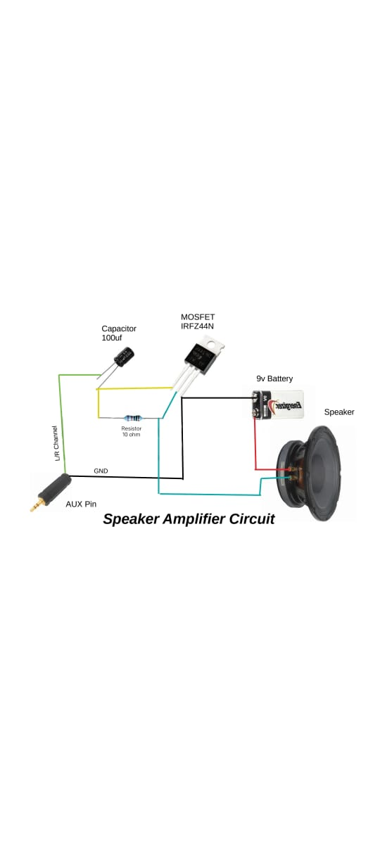
Speaker Audio Amplifier

Slide 5
Abstract
The need of this intermediate circuitry exists so that we can hear crystal clear music from the music systems. The signals given by an audio transmitter device such as cell phone through a 3.5mm audio jack cable is very low in amplitude. Such a signal if given to the speaker, the sound output given by the speaker will be very less and might not be audible even to a nearby person.

Slide 6
The amplifier circuitry amplifies this audio signal. Audio frequency range lies in the frequency range of 20Hz – 20KHz. The purpose of audio amplifier lies in to increase the amplitude of signals lying in this frequency range and suppress the rest. With the help of two potentiometers we can vary the gain factor or the volume of the audio amplifier.

Slide 7
Working Principle
An amplifier takes an input signal from a source, such as a laptop, turntable or CD player, and creates a larger copy of the original signal before it’s sent to the speakers.
It gets the power to do this from your mains electricity, which is sent directly to the power supply within the amplifier.

Slide 8
The transistor works like a valve, and determines the amount of current that flows through the circuit at any time. It bases that decision on the size of the input signal from the source.
The volume control is the final bit of the puzzle, which decides how much of this current is passed through to the speakers.

Slide 9
Components
IRFZ44N MOSFET
Speaker
9V Battery
10k Resistor
100uf Capacitor
AUX Pin

Slide 10
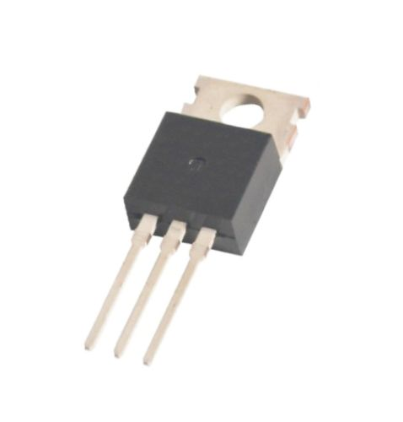
IRFZ44N MOSFET
The IRFZ44N is a N-channel MOSFET with a high drain current of 49A and low Rds value of 17.5 mΩ. It also has a low threshold voltage of 4V at which the MOSFET will start conducting. Hence it is commonly used with microcontrollers to drive with 5V.

Slide 11
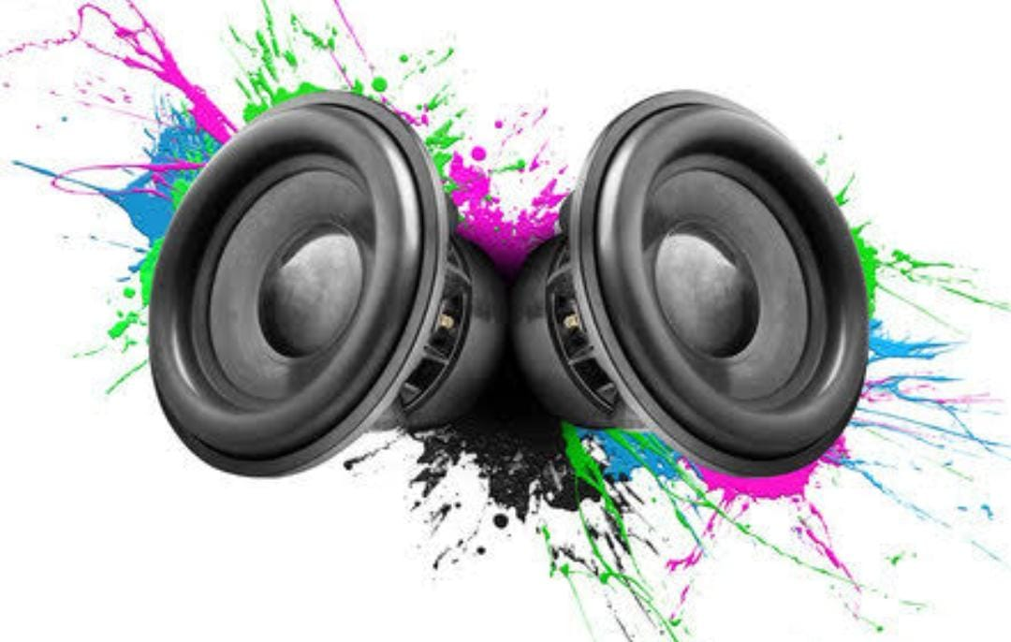
Speaker
An amplifier is a component of your sound system that not only powers your speakers, but lets you select the sound source and control the volume. In its simplest form, a stereo amp handles two channels, the left and the right, both of which make up the audio you hear.

Slide 12
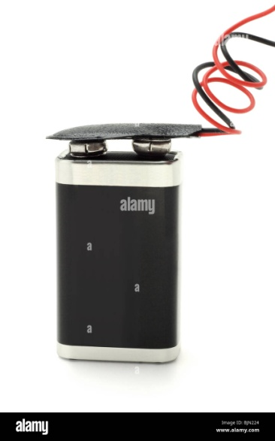
9V Battery
The nine-volt battery, or 9-volt battery, is an electric battery that supplies a nominal voltage of 9 volts. Actual voltage measures 7.2 to 9.6 volts, depending on battery chemistry. Batteries of various sizes and capacities are manufactured; a very common size is known as PP3, introduced for early transistor radios.

Slide 13
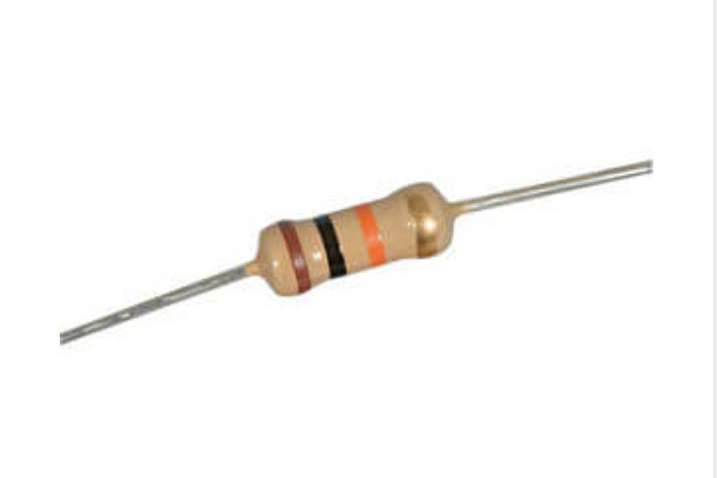
10k Resistor
Commonly used in breadboards and perf boards, these 10K resistors make excellent pull-ups, pull-downs, and current limiters.
A 10k ohm resistor has 4 color band: brown, black, orange, and gold for 5% tolerance, respectively.

Slide 14
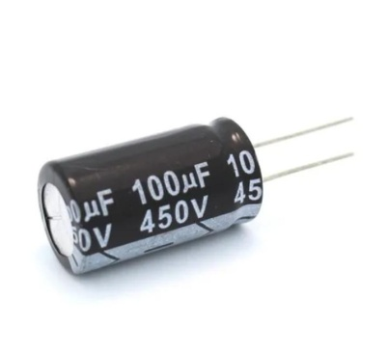
100uf Capacitor
The 100uF cap (the bulk capacitor) is primarily to support the supply during temporary battery disconnection during physical shock (eg: banging or dropping).

Slide 15
Advantages
It has wide frequency response and large bandwidth.
It is most convenient and least expensive amplifier.
It provides high audio fidelity.
It has low amplitude distortion.
It provides low frequency distortion.

Slide 16
Applications
In the sound systems, these amplifiers are most widely used.
In various instruments that relate to music, these amplifiers are installed.

Slide 17
In the radio signals broadcasting these amplifiers are used.
The signal transmission for long-distance communication is the most amplifiers that are utilized.
For the wireless transmission of the signals, audio amplification is required.

Slide 18
Reference
Audio Power Amplifier Design Handbook(Third Edition)
-By Douglas Self MA, MSc

Slide 19
COMPONENTS ESTIMATION
IRFZ44N MOSFET 318/-
Speaker 100/-
9V Battery 176/-
10k Resistor 34/-
100uf Capacitor 2.45/-

Slide 20


